Slide 1
Basic Understanding of electric vehicle

Slide 2
Basics of electrical engineering
AC VS DC

Slide 3
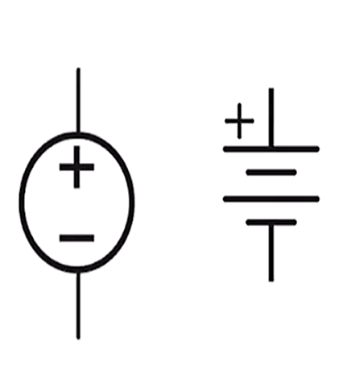
Direct Current
DC provides a constant voltage or current.
The flow of charge that flows only in one direction.
+
Voltage
Time
-

Slide 4
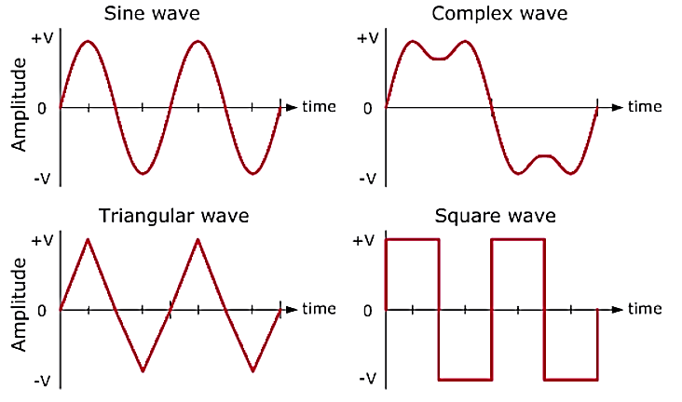

AC
Alternating Current :
The flow of charge that changes direction periodically.
AC can be produced using a device called an alternator.
Types:
+

Slide 5
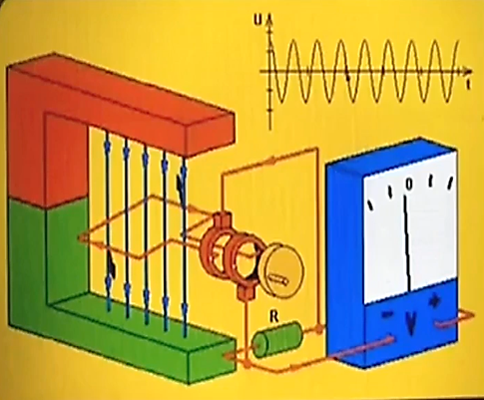
Ac Generation
In india we use 240 V , 50Hz "frequency"
At generation level we generate only AC.

Slide 6
How Dc is generated?
Use of a device called a rectifier that converts AC to DC.
Battery (Chemical Reaction )
An AC generator equipped with a device called a commutator can produce direct current

Slide 7
AC VS DC
AC | DC
AC is safe to transfer longer distance even between two cities, and maintain the electric power | DC cannot travel for a very long distance. It loses electric power.
The rotating magnets cause the change in direction of electric flow. | The steady magnetism makes DC flow in a single direction.
The frequency of AC is dependent upon the country. But, generally, the frequency is 50 Hz or 60 Hz. | DC has no frequency of zero frequency.
In AC the flow of current changes its direction backwards periodically. | It flows in a single direction steadily.
Electrons in AC keep changing its directions — backward and forward | Electrons only move in one direction — that is forward.
Home Appliances, Commercial Usage | Electronics

Slide 8
Thank You

